Slide 1
Interacting with your Computer
InPut/OutPut Devices

Slide 2
Input Devices
Enables you to enter information and commands into the computer.
If computer is brain, input devices are sensory organs
Key board and mouse are the most commonly used input devices

Slide 3
Keyboards
Primary input device for entering text and numbers
A standard keyboard include about 100 keys
Each key sends a different signal to the CPU

Slide 4
Standard Keyboard Layout
Alphanumeric Keys
Modifier Keys
Numeric Keypad
Function Keys
Cursor Movement Keys
Special purpose Keys

Slide 5
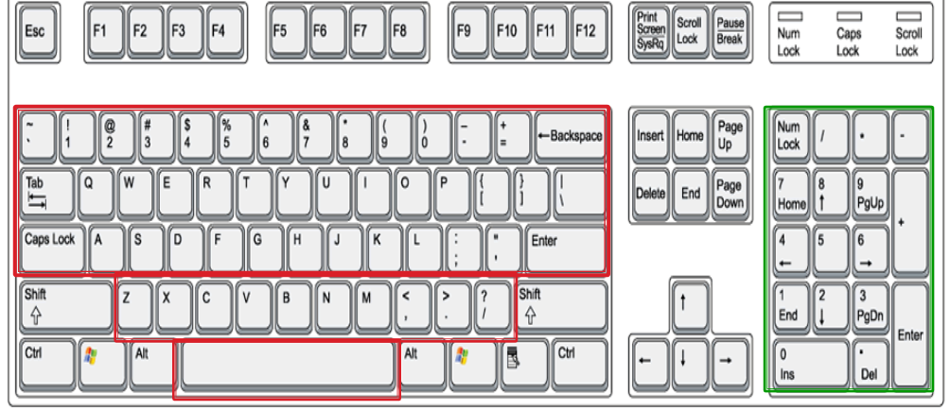
Standard Keyboard Layout

Slide 6
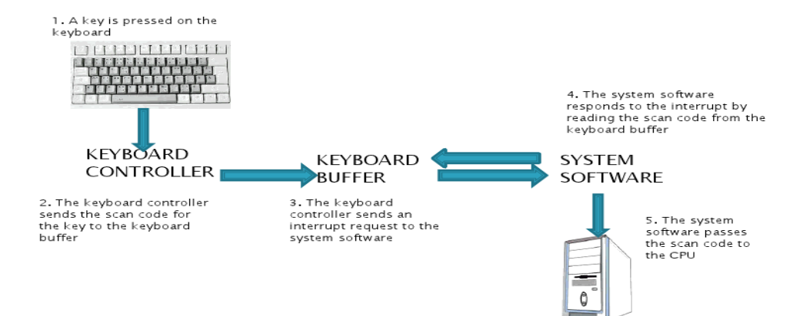
How Computer accepts input from Keyboard

Slide 7
Mouse
Every PC now a days include a mouse as the pointing device
Input device that you can move around on a flat surface
Controls the pointer
Onscreen object, usually an arrow, that is used to select text; access menus; and interact with programs, files or data that appear on the screen

Slide 8
Mechanical Mouse
Contains a small rubber ball that is placed inside a hole in the bottom of the mouse’s case
The ball rolls inside the case when you move the mouse around on flat surface
Rollers and sensors inside the mouse send signals to the computer, telling it the distance, direction and speed of the ball’s motion
The computer uses this data to position the mouse pointer on the screen

Slide 9
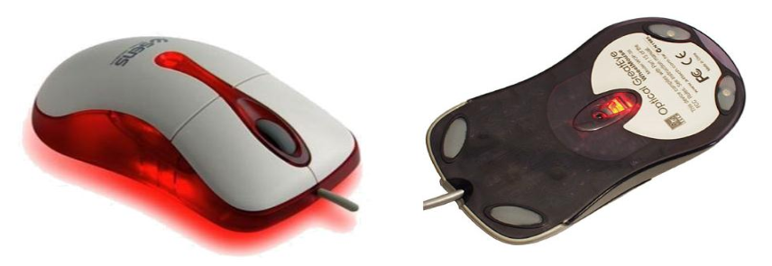
Optical Mouse
Emits a beam of light from its underside
Uses light reflection to judge the distance, direction and speed of its travel

Slide 10
Using the mouse
Pointing
Clicking
Double-clicking
Dragging
Right-clicking

Slide 11
Variants of Mouse
Devices that duplicate the mouse’s functionality but interact with the user in different ways
Trackballs
Track pads
Pointers in the keyboard

Slide 12
Ergonomics & input devices
Study of physical relationship between people and their tools – e.g. computer

Slide 13
Assignment#2
Q1: Describe other ways of inputting into the computer
Q2: what is ergonomics? Mention some stress injuries caused by computers. How can we minimize these injuries
Q3: Write a note on output devices.
Submission date: 18th sep, 2014
Create a word document for the assignment. Hard written assignments are not acceptable
Submit at: \\192.168.13.1 -> Rabiya Rashid -> computer Fundamentals- se23 -> Assignment2 submission ( copy your word document and paste it by right-clicking on the submission folder) . You need to submit hard copy as well. Try to be precise and write in your own words!

